Slide 1
Networking Fundamentals
Foundations of Ethernet and IP

Slide 2
Network Components
#
Routers, switches and firewalls

Slide 3
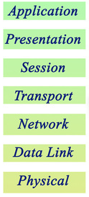
OSI Model
Communication function model for OSI protocol suite
Network engineers generally care about 1-4 then 7
Good to be comfortable with conceptualizing the layers for troubleshooting

Slide 4
Protocol Data Units
Protocols
Protocol Data Units
TCP, UDP
Segment or Datagram
IP, ICMP, OSPF
Packet
Ethernet
Frame
RJ45, 802.11
Bit

Slide 5
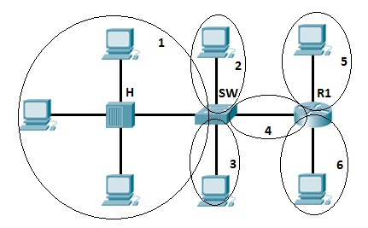
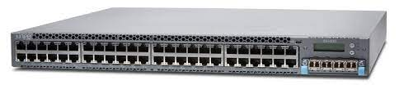
Layer 2 Switches
Separate collision domain per port
Primary job is to learn what port MACs live on
Only interact with traffic up to layer 2 of OSI model
Used for end-devices to connect into the network
Juniper EX4300-48T

Slide 6
Layer 3 Switches
Same as layer 2 switches, but include IP routing
Interact with traffic up to layer 3
Typically not as full featured as routers
Typically used as upstream switches for inter-vlan routing and policies
Juniper EX4300-48T

Slide 7
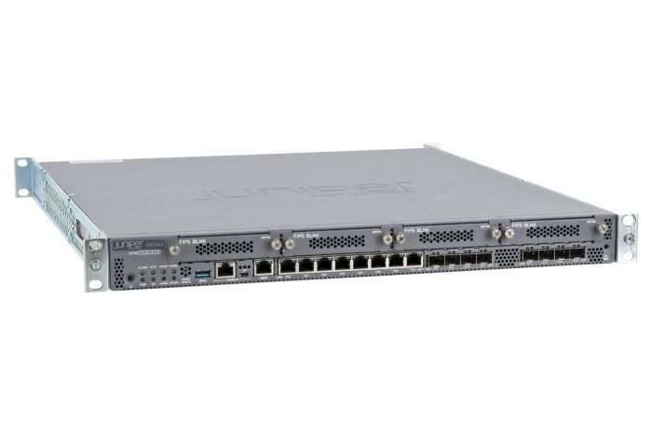
Routers
Generally better interacting with traffic at layers 3 and 4
Usually fewer ports than switches
Typically an edge device that provides more CPU intensive services
Juniper SRX345

